Slide 1
Caesarean Scar Ectopic

Slide 2
Ectopic Pregnancy
The word Ectopic means “Out of the place”
The blastocyst normally implants in the endometrial lining of the uterine cavity. Implantation anywhere else is considered as Ectopic Pregnancy.
Ectopic pregnancy accounts for 4 out of 10 percent of all pregnancy related deaths.

Slide 3
Sites of Ectopic Pregnancy
The most common sites for an ectopic pregnancies are:
Ampullary mid portion of the fallopian tube (80-90%)
Isthmic portion of the fallopian tube (5-10%)
Fimbrial end of the fallopian tube (about 5%)
Cornual (1-2%)
Abdomen (1-2%)
Ovary (<1%)
Cervix (<1%)
Previous Uterine Scar (<1%)

Slide 4
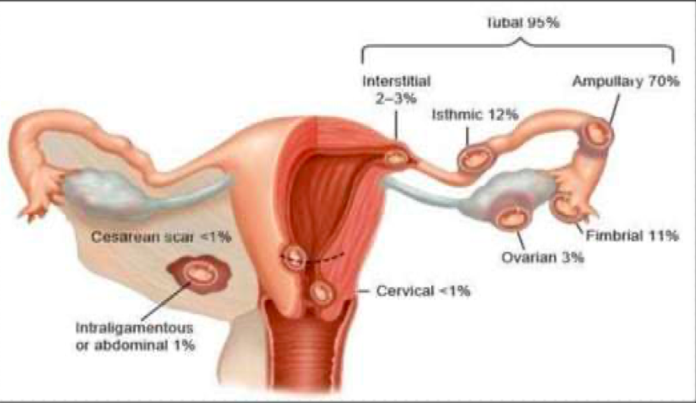
Caption

Slide 5
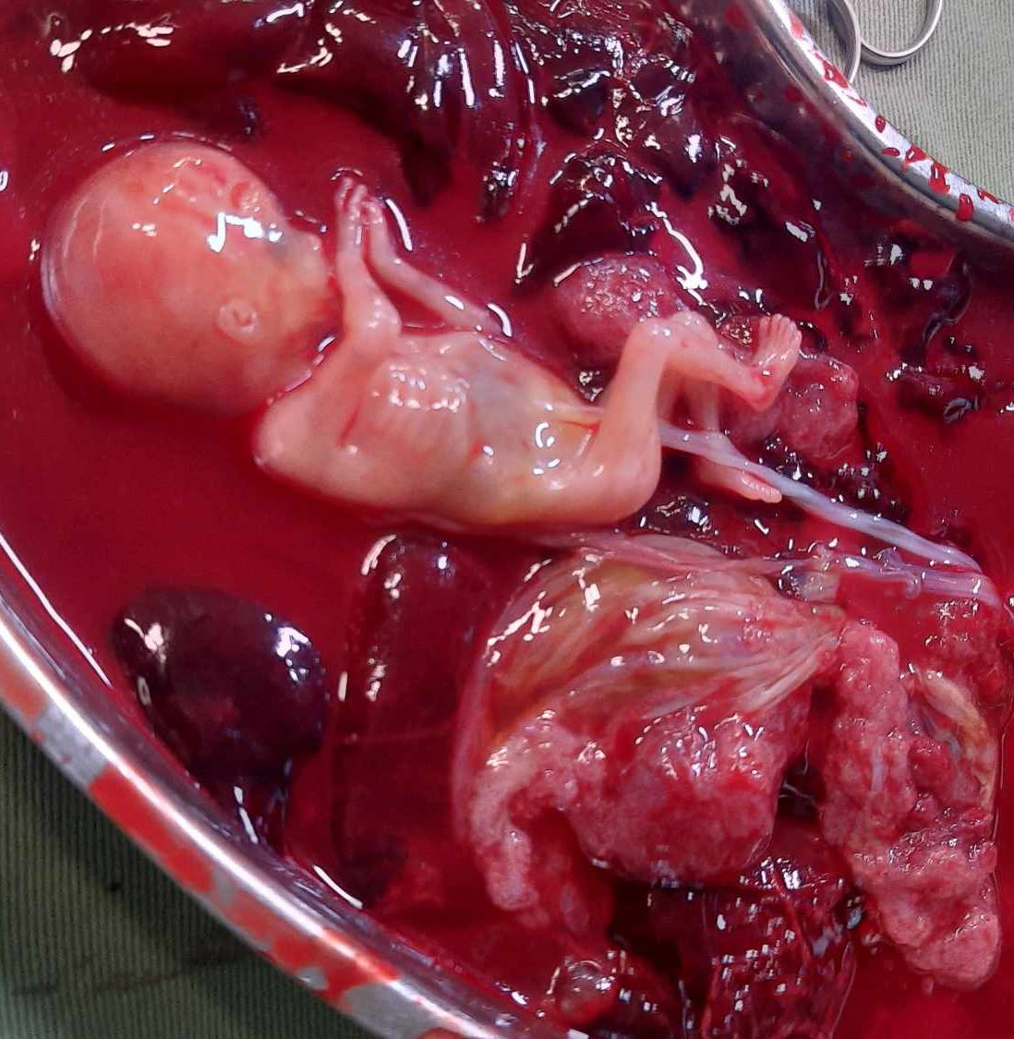
Scar Ectopic
Caesarean scar pregnancy (CSP) is an ectopic pregnancy implanted in the myometrium at the site of previous caesarean section scar.
It was recently estimated about 1 out of 531 women with a previous C/S will have CSP.
Gestational age at diagnosis is 5 to 12.5 weeks.

Slide 6
Pathophysiology
Endometrial and myometrial disruption of scar are predisposing factors.
Invasion by the implanting blastocyst through a microscopic tract that develops from the trauma of an earlier Caesarean section.
The risk of scar implantation might be proportional to the size of the anterior uterine wall defect.
Caesarean section for a breech presentation in a previous pregnancy appears to be most frequently at risk of future CSP.

Slide 7
It may be secondary to:
Systemic diseases such as Diabetes.
Improper closure.
Poor tissue quality:-
    Inadequate collagen formation
    Post operative wound infection
    Short interval pregnancy

Slide 8
Risk Factors
There are several factors that may occur after any myometrial trauma:-
Caesarean section
Manual removal of placenta
Myomectomy
Dilation & Curettage

Slide 9
There is an increase in scar ectopic pregnancy because:
Due to enormous increase in Caesarean section rate
Improved diagnostic techniques like 3D sonography, MRI.

Slide 10
Types
Based on USG scan and pregnancy progression, CSP is of two types:
Endogenic CSP: Implantation occurs on the scar and the gestational sac grows towards cervico-isthmic or uterine cavity.
Exogenic CSP: Gestational sac is deeply embedded in the scar and surrounding myometrium and grows towards bladder.

Slide 11
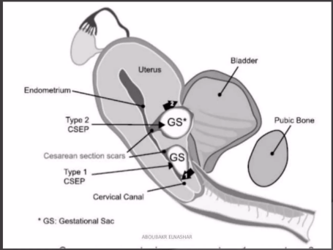

Slide 12
Clinical Presentation
CSP may present from as early as 5-6 weeks to as late as 16weeks.
A light painless vaginal bleeding (39%)
Abdominal pain with bleeding (16%)
Only abdominal pain (9%)
Incidental finding in an asymptomatic woman (37%)
Severe acute abdominal pain with profuse bleeding implies an impending rupture
Collapse or hemodynamic instability indicates ruptured CSP.

Slide 13
HOW DO WE DIAGNOSE CSP?
We should consider following criteria for diagnosing CSP
History of amenorrhoea followed by bleeding
Positive pregnancy test
Transvaginal Ultrasound

Slide 14
Ultrasound :
This is the first line diagnostic tool for CSP. To diagnose CSP from USG some criteria have been presented below.
Empty uterine cavity, closed and empty cervical canal
Placenta or gestational sac embedded in the scar of a previous caesarean section
Triangular/round or oval- shaped gestational sac that fills niche of the scar

Slide 15
A thin or absent myometrial layer between the gestation sac and the bladder
Negative “sliding organs” sign
Evidence of functional trophoblastic/placental circulation on colour flow Doppler examination.

Slide 16
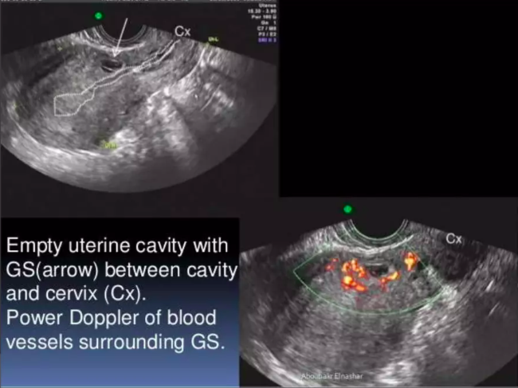
TVS 3D ultrasound with Doppler identifies peritrophoblastic vascular flow in the tissue surrounding the sac and measurement of the myometrial thickness is relatively easier. Can show the relation of placenta to the scar and bladder

Slide 17
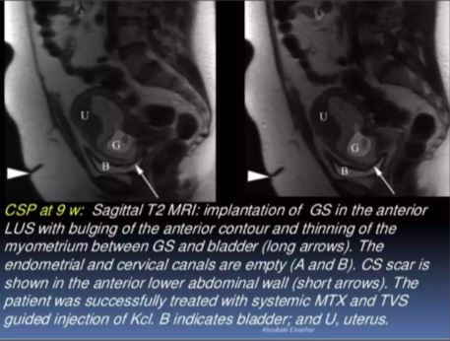
MRI : Can measure the volume of the lesion and thus help assess the indication and success of local methotrexate. Can also improve intraoperative orientation.

Slide 18
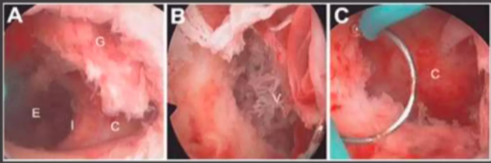
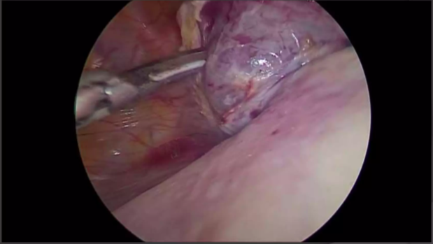
Diagnostic Laparoscopy : Uterus is usually seen normal sized or bulky with the CSP arising as a hillock with a “Salmon red” ecchymotic appearance, bulging the uterine serosa from the previous caesarean section scar behind the bladder.
Hysteroscopic Diagnosis Laparoscopic Picture

Slide 19
Differential Diagnosis
Spontaneous Abortion
Cervicoisthmic Pregnancy
Trophoblastic Tumor
Very low implanted intrauterine pregnancy

Slide 20
Prevention
Advise for birth spacing at least 2 yrs.
Surgical repair of uterine scar defects with single or double layer closure

Slide 21
Management
Treatment of CSP should be evidence based and focused on
Prevention of severe complications
Conservation of fertility.

Slide 22
I. Expectant Management
If patient wants to continue the pregnancy
There is sonographic evidence of the sac growing towards the uterine cavity; Expectant management can be considered at life threatening risks.
The efficacy is low (41.5%) and complication rate is high (53.7%)

Slide 23
II. Medical Management
Systemic Methotrexate
Local injection of Embryocides
Medical treatment combined with surgical sac aspiration

Slide 24
A. Systemic methotrexate
Dose: single dose of 50mg/m² IM
Criteria: Hemodynamic stable patient without pain.
    Gestation age < 8weeks
    Myometrium thickness <2mm between pregnancy and bladder
    Serum hCG <5000IU/L
    Gestational sac <2.5 cm
    No fetal heart rate.
Complication rate is 13%

Slide 25
B. Local injection of embryocides
Local injection of MTX, potassium chloride, hyperosmolar glucose36 has been used for termination of the pregnancy.
Methotrexate always has been preferred agent.
Under USG guidance, MTX can be injected locally to the gestation sac via transabdominal or via transvaginal route.

Slide 26
C. Medical treatment combined with surgical sac aspiration
Local potassium chloride/ Local or intramuscular MTX injection with TVS guided sac aspiration.
Systemic MTX/ TVS guided sac aspiration.

Slide 27
III. Surgical Management
Uterine Curettage
Hysteroscopic evacuation
Laparoscopic removal
Primary open surgical treatment
Hysterectomy

Slide 28
A. Uterine curettage
Gestation sac of a CSP is not actually within the uterine cavity. Trophoblastic tissue is unreachable by the curette but also such attempts can potentially rupture the uterine scar.
Suction curettage can be done under USG guidance when gestation is <7weeks and myometrial thickness anterior to CSP is >3.5mm
Complication rate 21%

Slide 29
B. Hysteroscopic Evacuation
Gestational sac dissected free of the uterine wall through natural entrance, homeostasis can be achieved Electro-Coagulation using wire-loop or roller ball
Balloon catheter can be postoperatively for compression haemostasis and wound surface drainage
Complication rate 3.1%

Slide 30
C. Laparoscopic Removal
CSP mass is incised and pregnancy tissue removed in an endobag
Bleeding can be minimised by local injection of vasopressin
Hemostasis achieved by bipolar diathermy and uterine defect closed with endoscopic suturing
Success rate is high (97.1%)

Slide 31
D. Primary open surgical treatment
Laparotomy followed by wedge resection of the lesion should be considered for women who do not respond to conservative medical management.
Laparotomy is mandatory when uterine rupture is confirmed or strongly suspected
Higher chance of placenta accrete in the future.

Slide 32
E. Hysterectomy
It is not advised as a primary procedure of treatment except in cases of intractable haemorrhage due to rupture.
Generally used as last resort to previously failed procedures or any life threatening complications.

Slide 33
Complications
Placenta previa/ accerta
Uterine rupture
Massive Haemorrhage: Increased maternal morbidity and mortality.

Slide 34
Summary
CSP is an uncommon but potentially life-threatening condition.
The incidence is rising as Caesarean section is rising.
Precursor of morbidity adherent placenta.
Do not confuse CSP with ectopic pregnancy.
Early diagnosis is important.
TVS is the most effective and preferred diagnostic tool.
Determine whether heart activity is present.

Slide 35
If heart activity is documented : Counsel the patient.
Inform the patient of the risks of pregnancy continuation.
If continuation: An additional counselling session; risks should be explained
If termination: a reliable treatment that stops fetal heart beat without delay.

Slide 36
Thank you!

